Slide 1

Time Series Overview

Slide 2
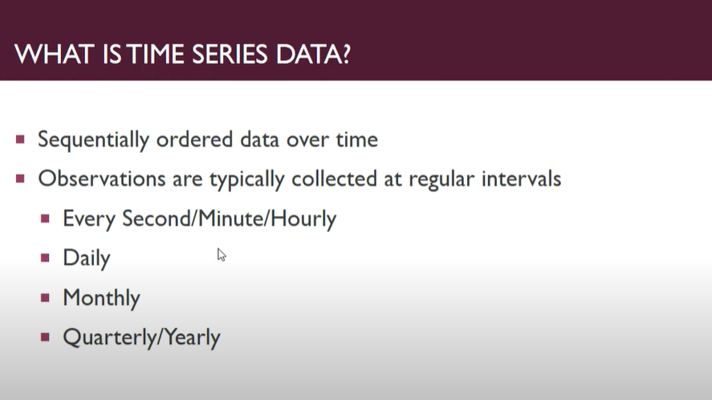
Assumption: Past Pattern and behavior continues in Future

Slide 3
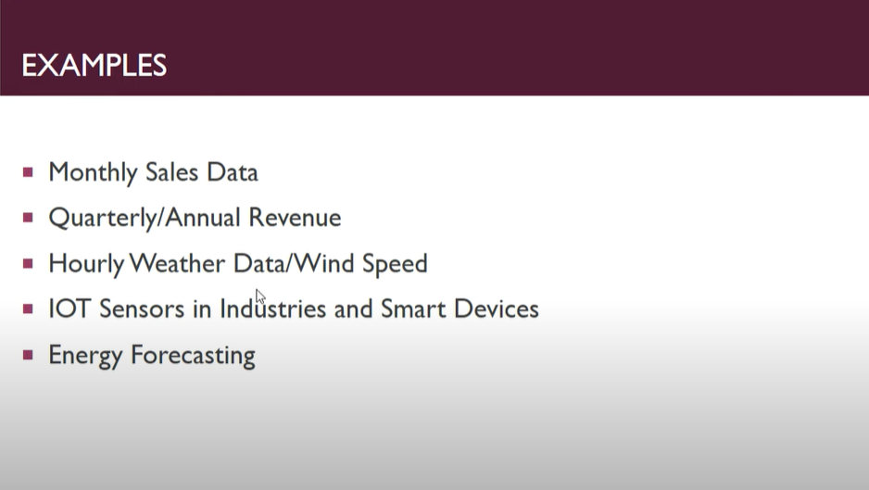

Slide 4
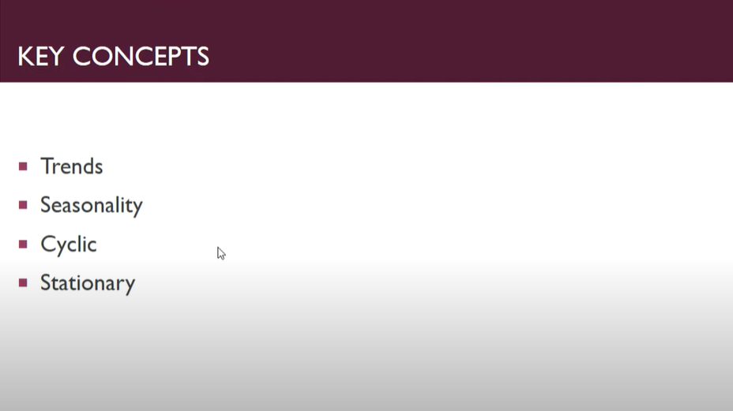

Slide 5
Trend
A trend exists when there is a long-term increase or decrease in the data. It does not have to be linear. Sometimes we will refer to a trend as “changing direction”, when it might go from an increasing trend to a decreasing trend.

Slide 6
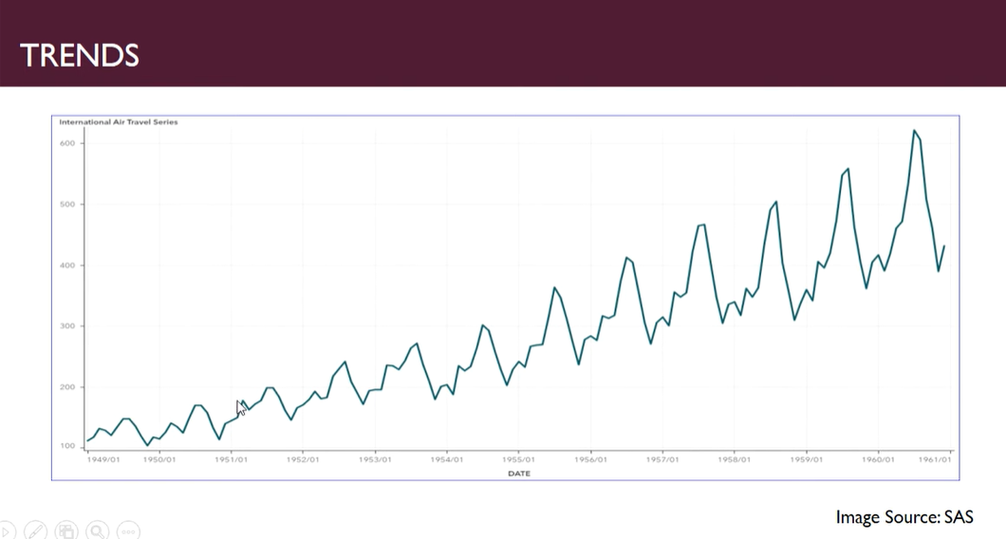

Slide 7
Seasonality
A seasonal pattern occurs when a time series is affected by seasonal factors such as the time of the year or the day of the week. Seasonality is always of a fixed and known period.

Slide 8
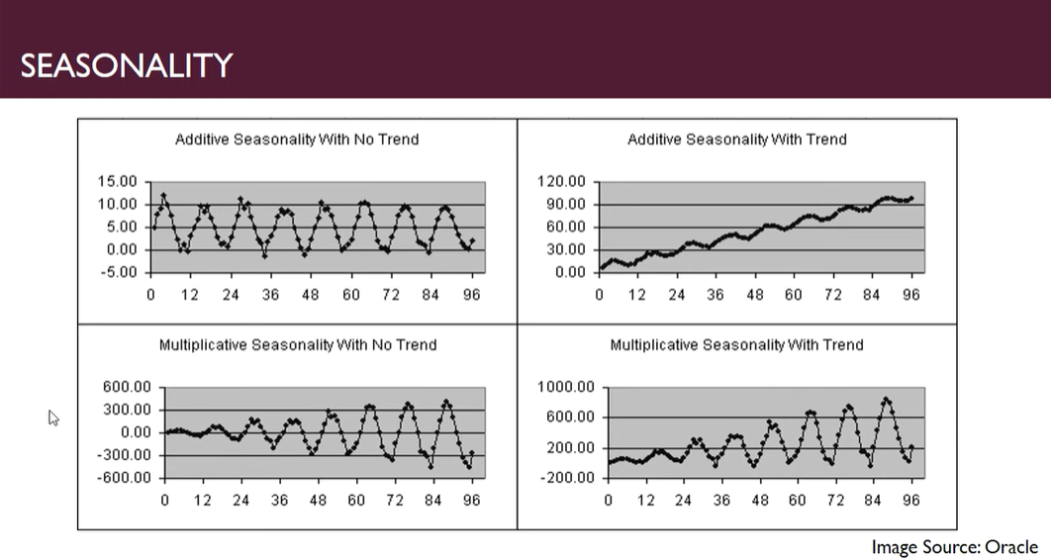

Slide 9
Cyclic
A cycle occurs when the data exhibit rises and falls that are not of a fixed frequency. These fluctuations are usually due to economic conditions, and are often related to the “business cycle”. The duration of these fluctuations is usually at least 2 years.

Slide 10
Many people confuse cyclic behaviour with seasonal behaviour, but they are really quite different.
If the fluctuations are not of a fixed frequency then they are cyclic;
if the frequency is unchanging and associated with some aspect of the calendar, then the pattern is seasonal.
In general, the average length of cycles is longer than the length of a seasonal pattern, and the magnitudes of cycles tend to be more variable than the magnitudes of seasonal patterns.

Slide 11
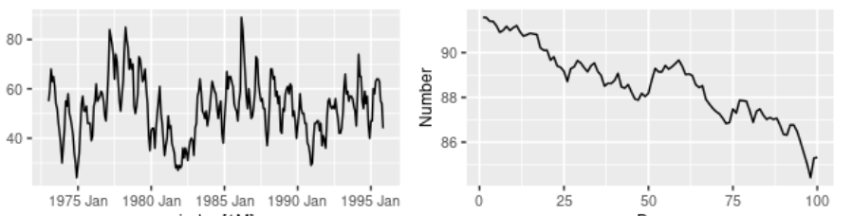
Show strong seasonality within each year, as well as some strong cyclic behaviour with a period of about 6–10 years. There is no apparent trend in the data over this period.
Here there is no seasonality, but an obvious downward trend. Possibly, if we had a much longer series, we would see that this downward trend is actually part of a long cycle, but when viewed over only 100 days it appears to be a trend.

Slide 12
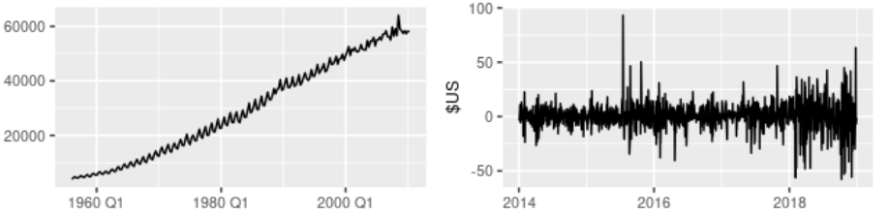
3. Shows a strong increasing trend, with strong seasonality. There is no evidence of any cyclic behaviour here.
4. Has no trend, seasonality or cyclic behaviour. There are random fluctuations which do not appear to be very predictable, and no strong patterns that would help with developing a forecasting model.

Slide 13
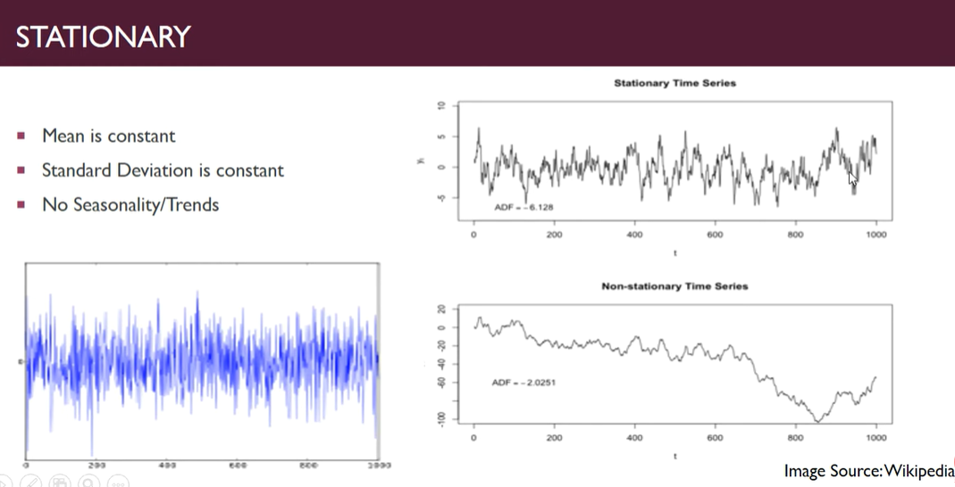

Slide 14
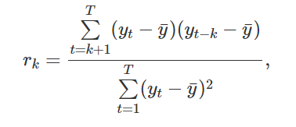
Auto Correlation
Just as correlation measures the extent of a linear relationship between two variables, autocorrelation measures the linear relationship between lagged values of a time series.

Slide 15
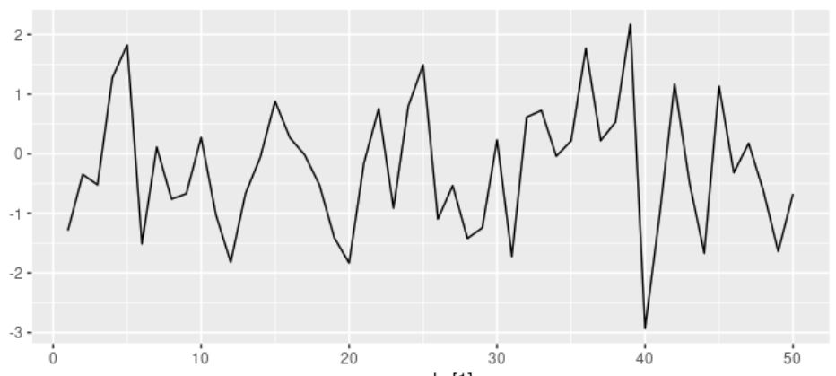
White Noise
Time series that show no autocorrelation are called white noise.

Slide 16
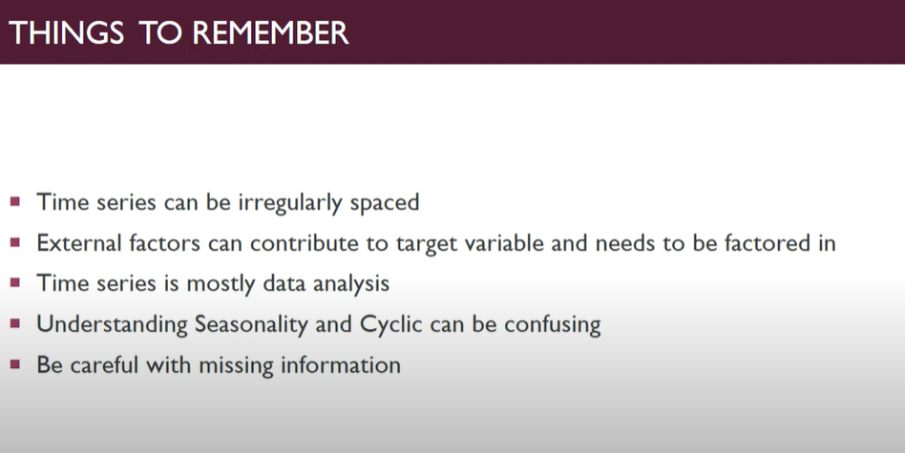

Slide 17
Thank You

